Slide 1
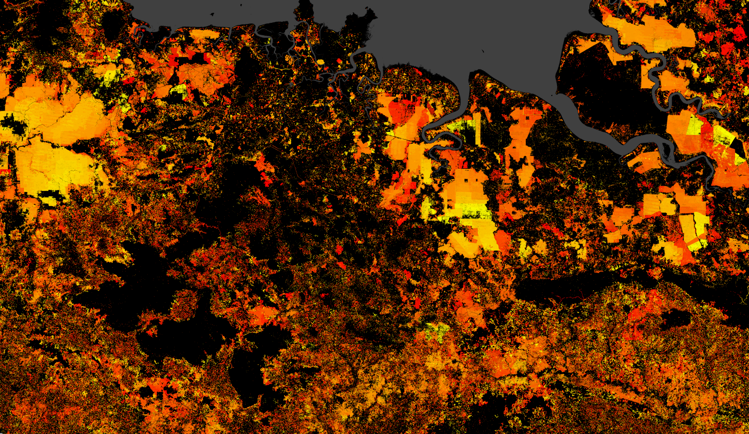
Land cover-land use data for infectious disease modelling

Slide 2
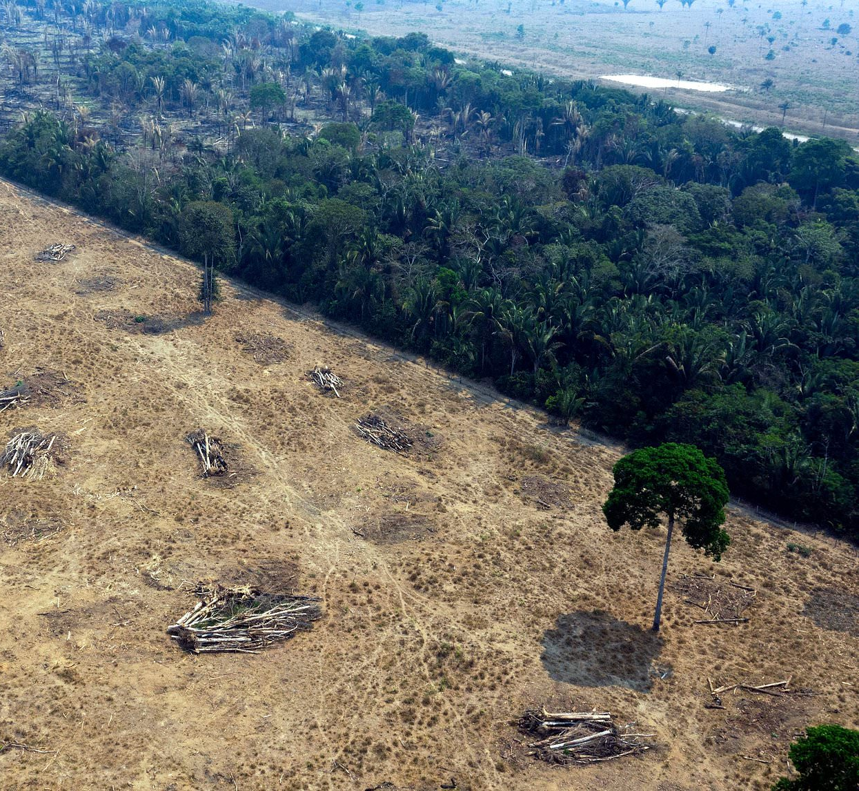
Landscape structure and human land use can influence pathogen transmission by altering, among other things, host and vector communities, hydrology, microclimates, and human-vector-wildlife contact.
Often, we want to explore or test for these effects– which generally requires spatially-explict, earth observation data on land cover and land use.

Slide 3
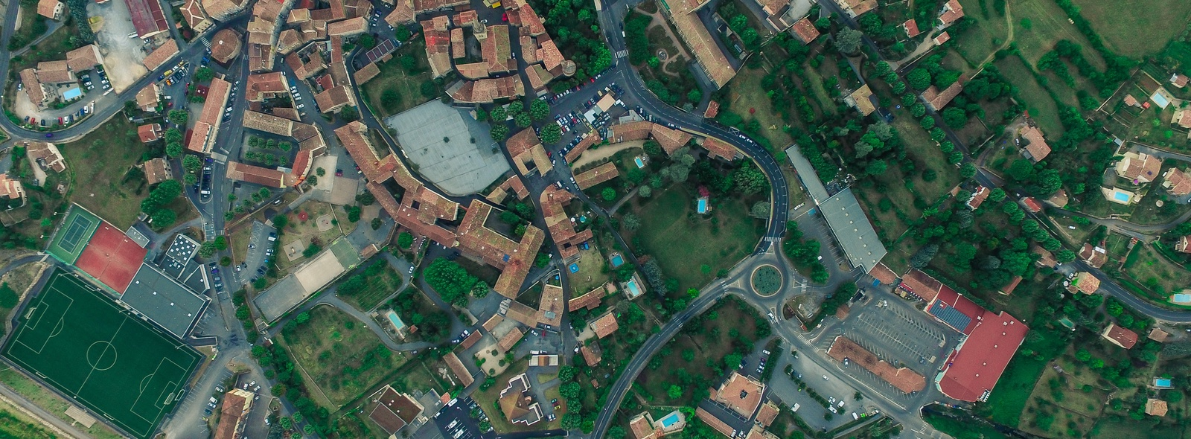
Land cover and land use – what’s the difference?
Image: Nicholas van Leekwijk, GeoWiki, https://www.geo-wiki.org/
Notes:
Here’s a city measured from above
If we were classifying coarsely, we might say this land is being used as a “city”
If we were classifying more finely, we might differentiate into more specific classes

Slide 4
Land cover and land use – what’s the difference?
Concrete
Trees
Concrete
Tarmac
Grass
Image: Nicholas van Leekwijk, GeoWiki, https://www.geo-wiki.org/
Notes:
These might reflect the land cover, i.e. what features are present on the land

Slide 5
Land cover and land use – what’s the difference?
Buildings
Recreational parkland
Road
Sports ground
Garden
Image: Nicholas van Leekwijk, GeoWiki, https://www.geo-wiki.org/
Notes:
Or they might reflect land use – how people are using these areas. However, this is much harder to measure remotely; how would we differentiate the park from the garden from space?

Slide 6


Earth observation satellites generally measure land cover
Notes:
Satellite takes images of the earth – these generally represent land cover or a kind of hybrid of land cover and land use – e.g. “city”

Slide 7
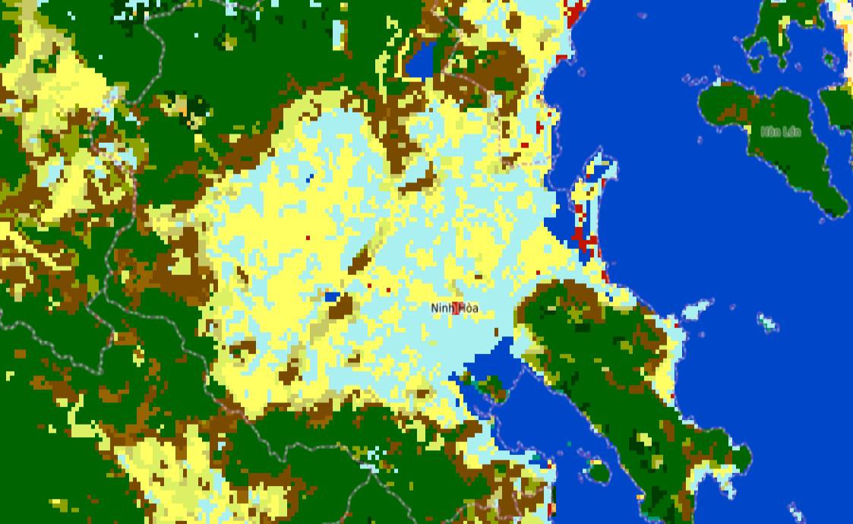
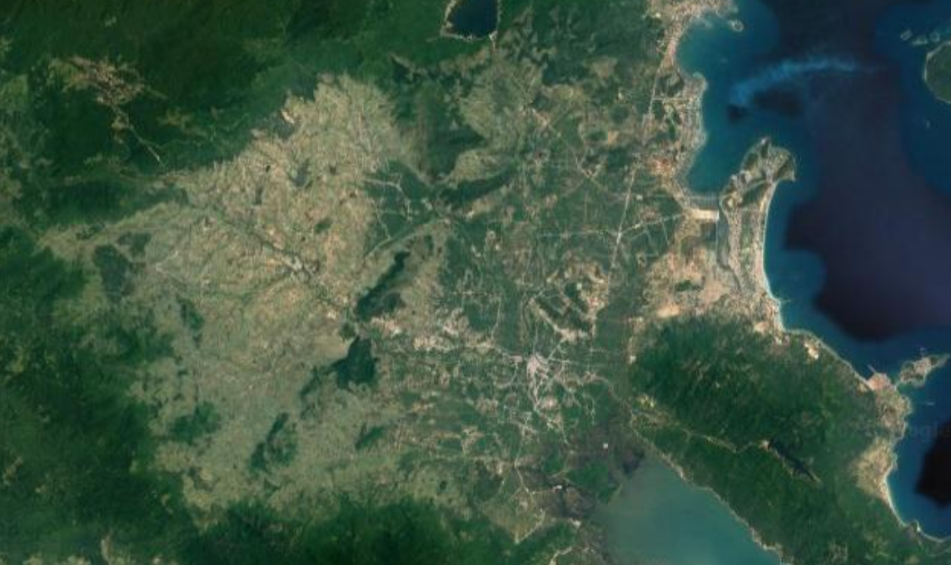
Earth observation satellites generally measure land cover
Satellite sensing
Image of Earth’s surface
Image processing and classification pipeline
Land cover class/proportion raster
e.g. random forest, neural network
Notes:
Here’s a simplified pipeline

Slide 8
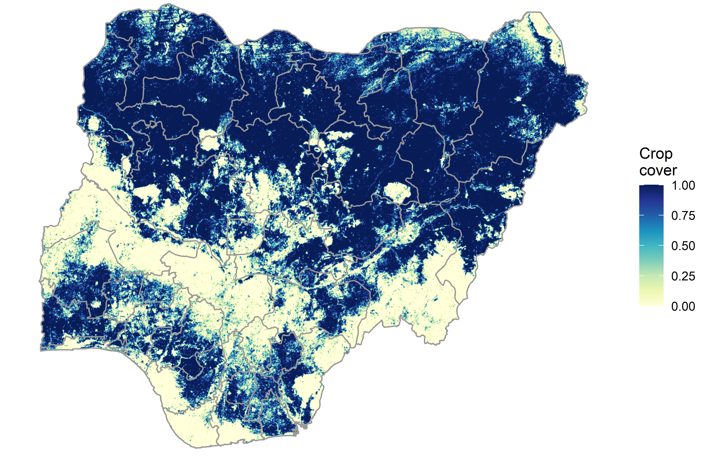
Earth observation satellites generally measure land cover
Nigeria cropland (2018 ESA-CCI)
Notes:
Cropland cover proxies for agricultural activity but != pasture, land management approach, pesticide input, water management

Slide 9

Earth observation satellites generally measure land cover – in some cases this can be used as a proxy for land use
Nigeria cropland (2018 ESA-CCI)
What about pasture grazing, cropping intensity, nutrient inputs, land management regimes?
Notes:
Cropland cover proxies for agricultural activity but != pasture, land management approach, pesticide input, water management

Slide 10
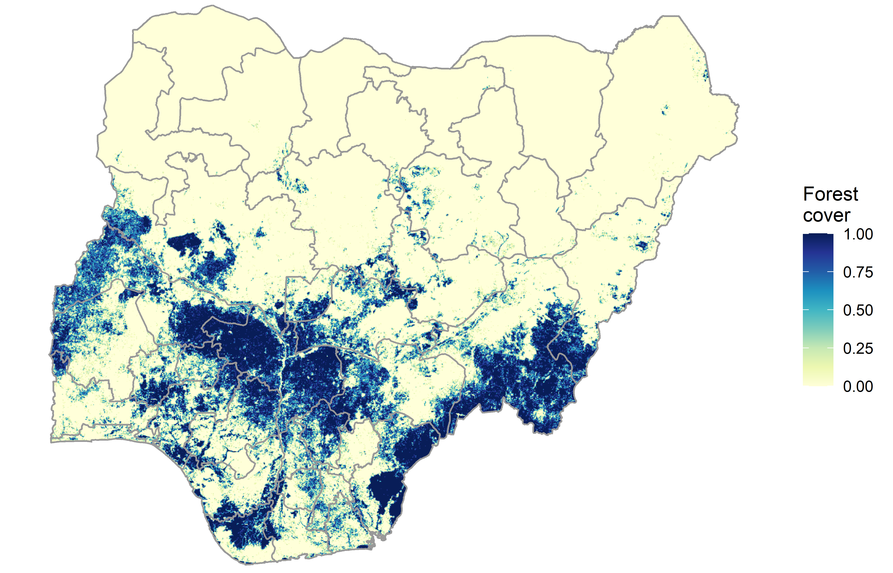
Earth observation satellites generally measure land cover – in some cases this can be used as a proxy for land use
Nigeria forest (2018 ESA-CCI)
What about selective logging, agroforestry, hunting pressure, timber plantations?
Geo-Wiki
https://www.geo-wiki.org/
Notes:
Forest cover != forest use (and this could matter)

Slide 11
Three axes of land cover data resolution
Temporal
Spatial
2000
Thematic
2005
2010
Low
High
Low
High
How finely resolved is the grid? (30m <-> 5km)
2015
How finely resolved are land cover classes?
How many years?
At what time intervals?
Notes:
Spatial – how high resolution spatially are we?
Temporal – how high resolution temporally are we? Annual? 5-year epoches? Decadal? And what kind of time series are we looking at?
Thematic – in what kind of detail are the land classes described? And how are grid-cells described: “single class” or proportion cover?
Good thematic resolution AND temporal resolution AND spatial resolution is challenging

Slide 12
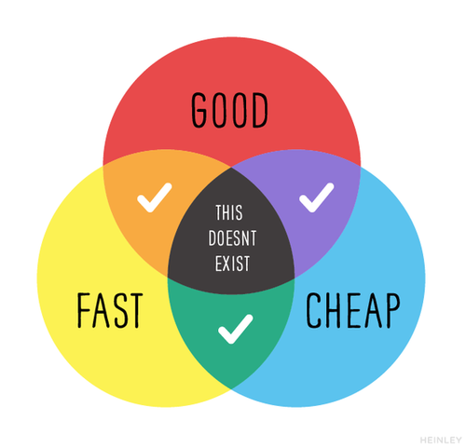
Pick two
https://medium.com/@devsociety_/good-cheap-fast-pick-two-and-how-ngos-can-play-the-triangle-like-a-pro-20d1380884a8
Notes:
You can only ever get 2 of these

Slide 13
Pick two
Spatial
00
Temporal
Thematic
Notes:
It’s a similar situation for land cover data (although not quite so bad and improving)

Slide 14
Pick two
Global Forest Change (“Hansen”) –
30m, annual since 2000, but only tree cover
COPERNICUS Global Land Cover –
100m, 23 classes and fractional cover,
but only for 2015 onwards
Spatial
00
Temporal
Thematic
ESA-CCI and MODIS land cover –
annual since 2000, >30 classes, but >300m spatial resolution

Slide 15
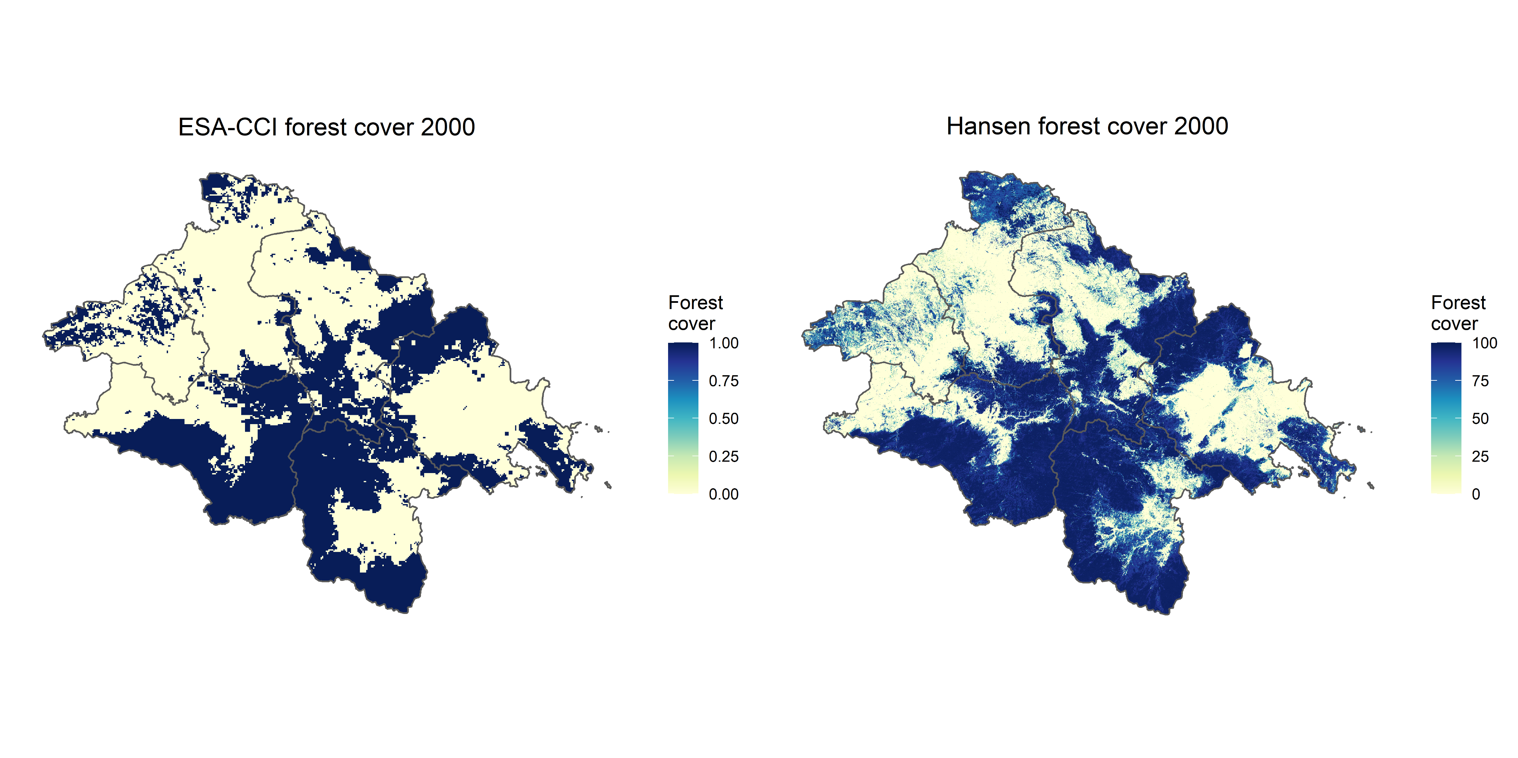
Why resolution matters: two views of the same area
ESA-CCI 2000 (300m res)
Global Forest Change 2000 (30m res)
Notes:
Landscapes are discretised into cells; often criterion of >50% cover masks what is actually highly heterogeneous
This could matter!
n.b. Land cover change time series often include a selection algorithm to determine when a class can “change” type but it’s notable that these may be restricted to certain transitions, e.g. ESA-CCI, which can impact our ability to quantify land cover change (i.e. the transition) – read the manual!

Slide 16
Why resolution matters: two views of the same area
ESA-CCI 2000 (300m res)
Global Forest Change 2000 (30m res)
The lower spatial resolution and discrete land cover class scheme of ESA-CCI classifies many areas with substantial tree cover as “non-forest”
Notes:
Landscapes are discretised into cells; often criterion of >50% cover masks what is actually highly heterogeneous
This could matter!
n.b. Land cover change time series often include a selection algorithm to determine when a class can “change” type but it’s notable that these may be restricted to certain transitions, e.g. ESA-CCI, which can impact our ability to quantify land cover change (i.e. the transition) – read the manual!

Slide 17
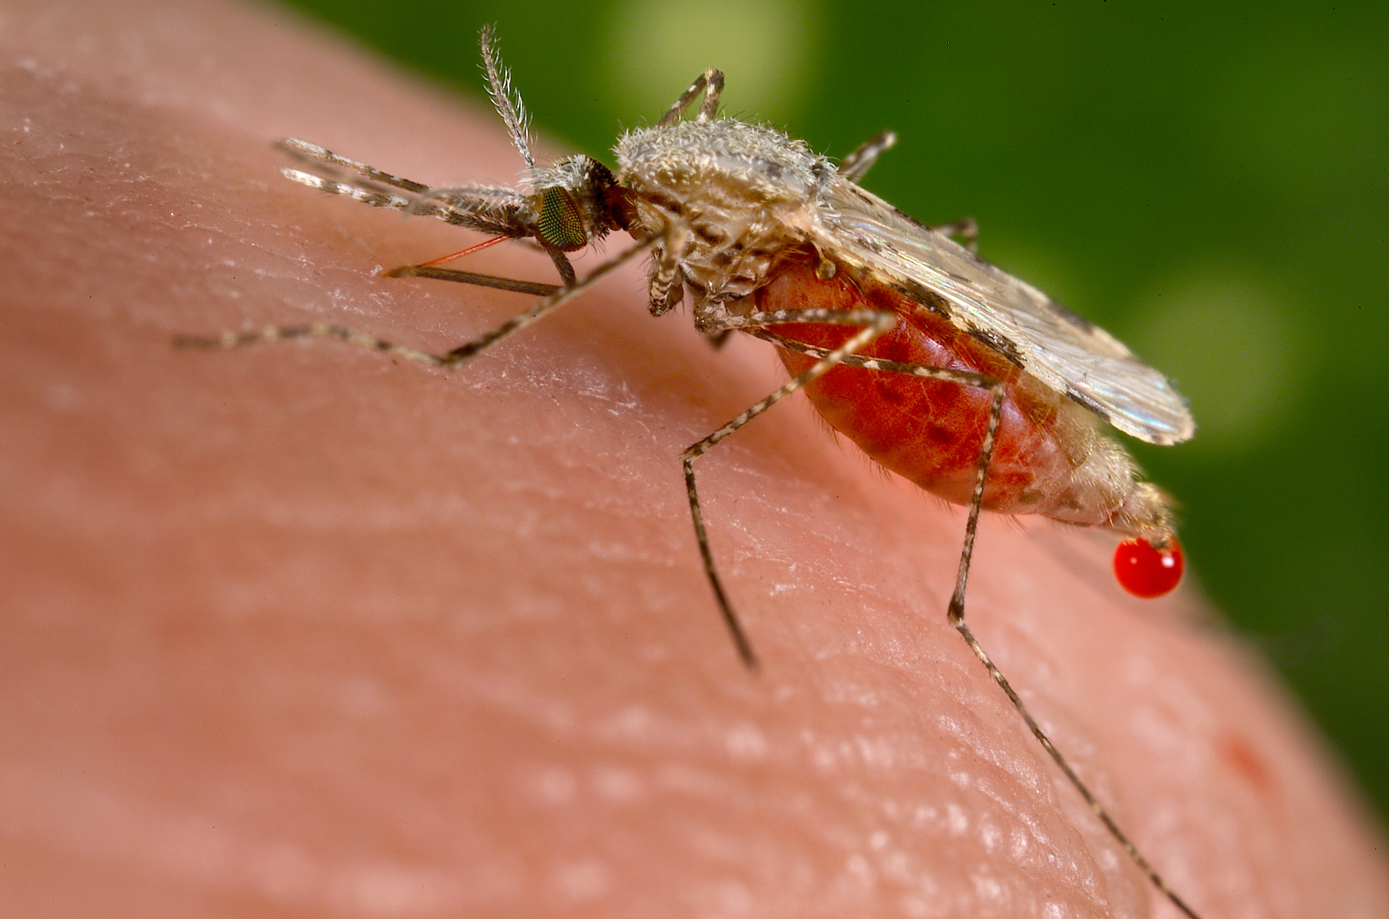

Why resolution matters: two views of the same area
ESA-CCI 2000 (300m res)
Global Forest Change 2000 (30m res)
This could matter, especially for zoonotic and vector-borne disease – it’s these kinds of boundary or fragmented areas that are often associated with human-wildlife-vector contact and spillover risk
Notes:
Landscapes are discretised into cells; often criterion of >50% cover masks what is actually highly heterogeneous
This could matter!
n.b. Land cover change time series often include a selection algorithm to determine when a class can “change” type but it’s notable that these may be restricted to certain transitions, e.g. ESA-CCI, which can impact our ability to quantify land cover change (i.e. the transition) – read the manual!

Slide 18

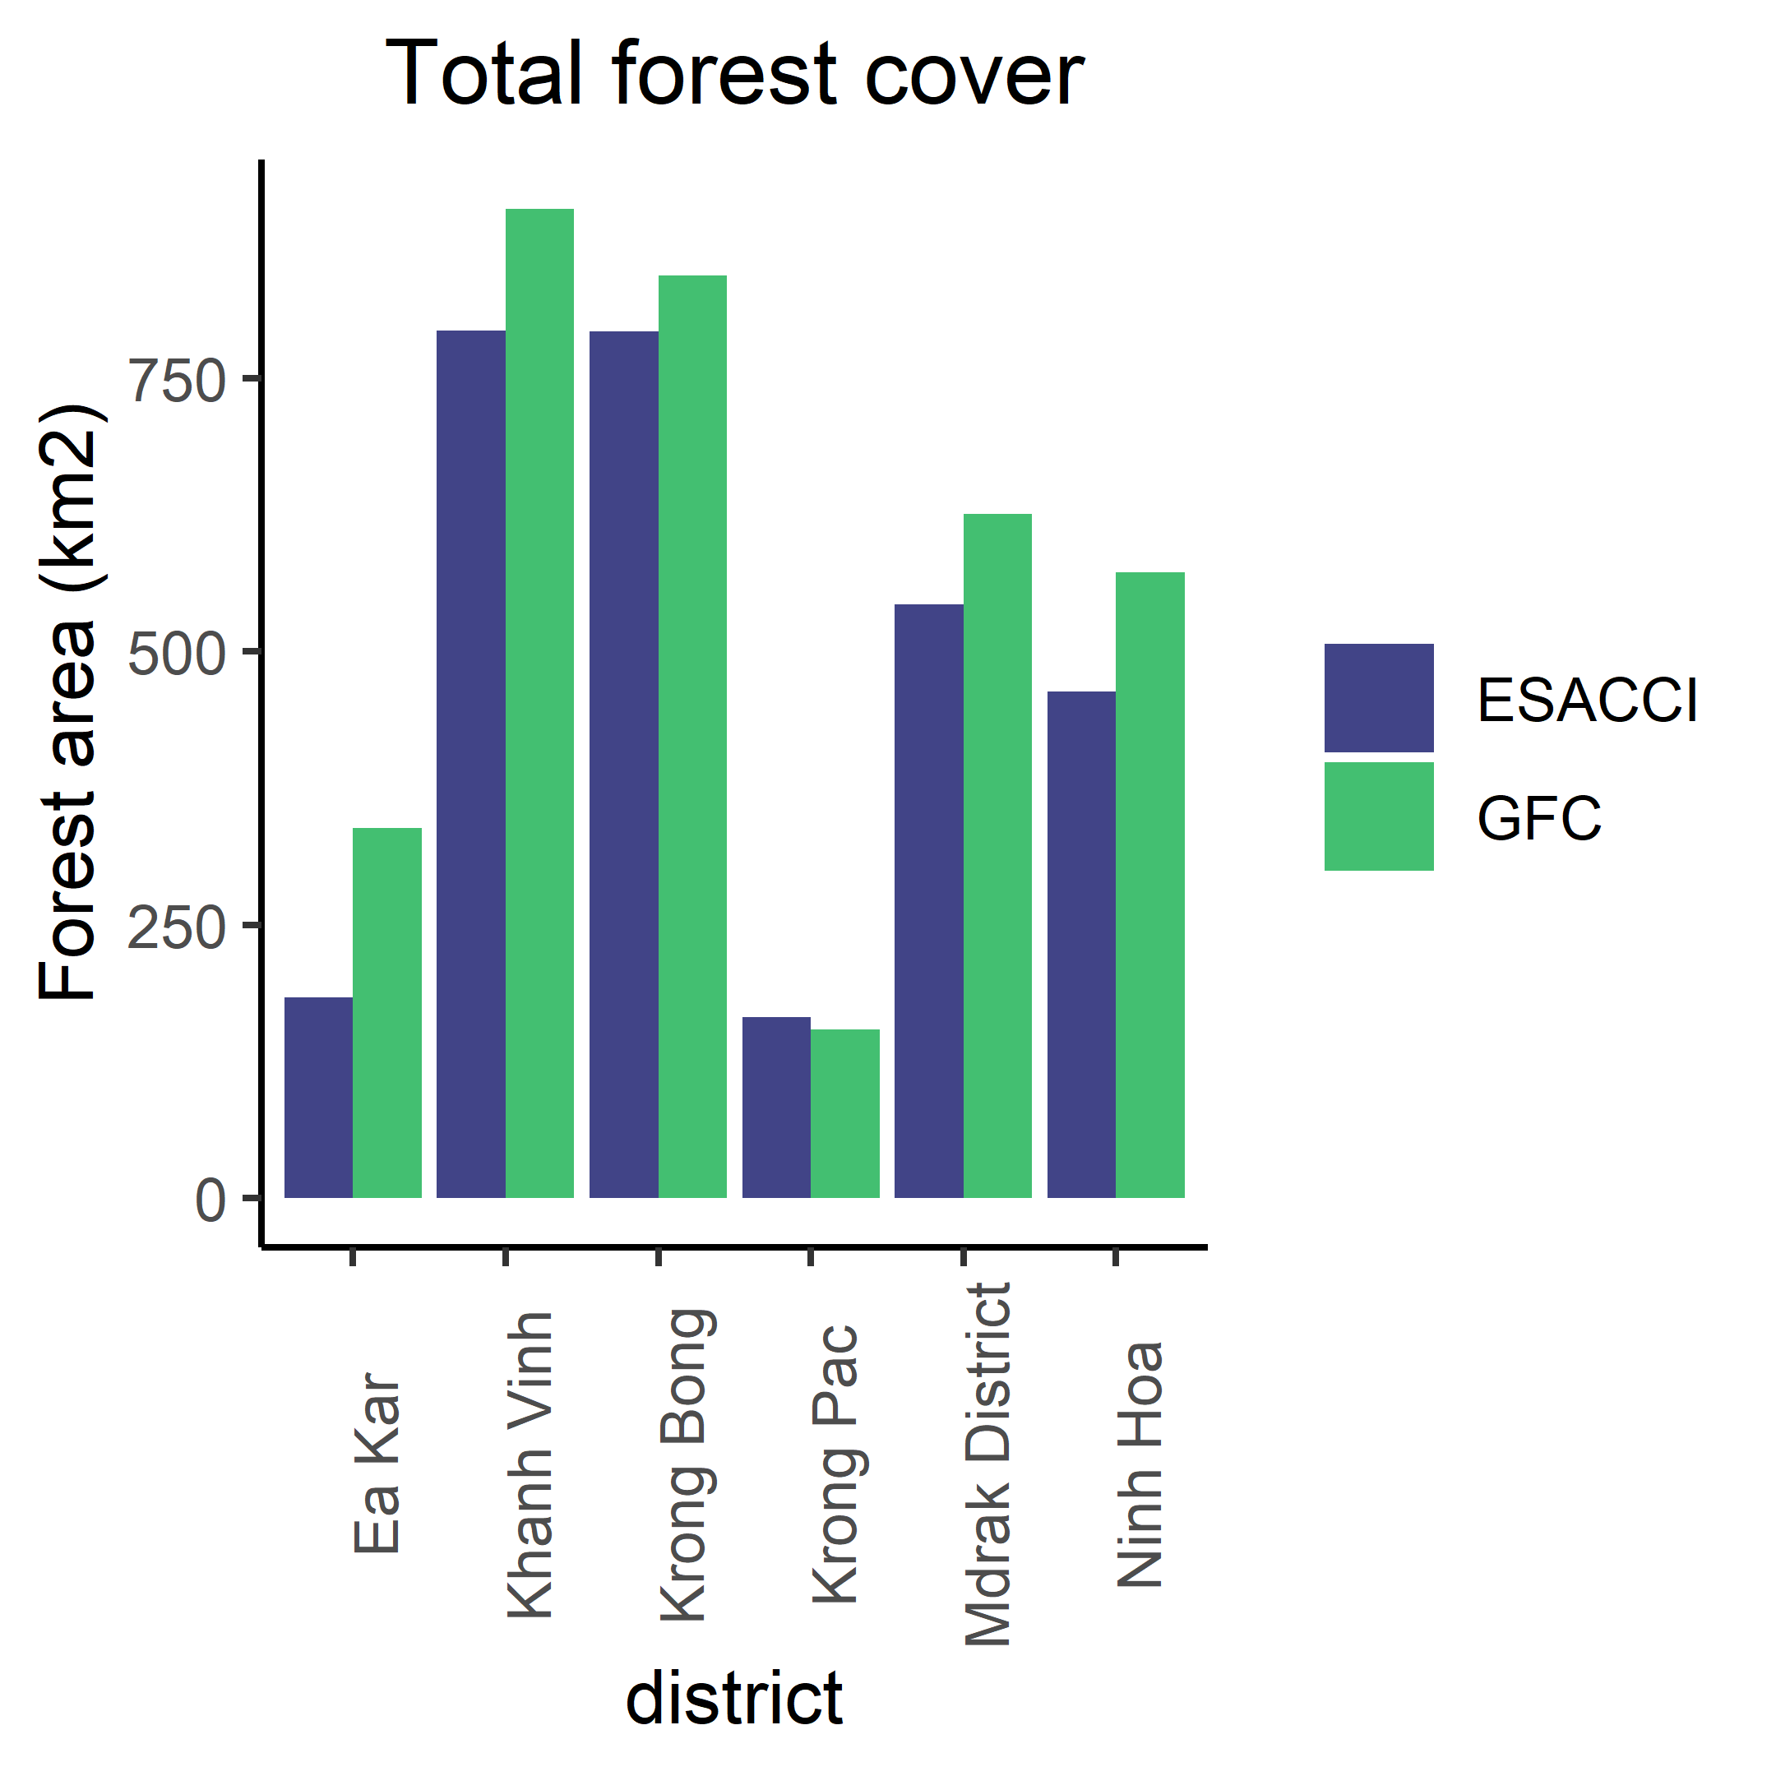
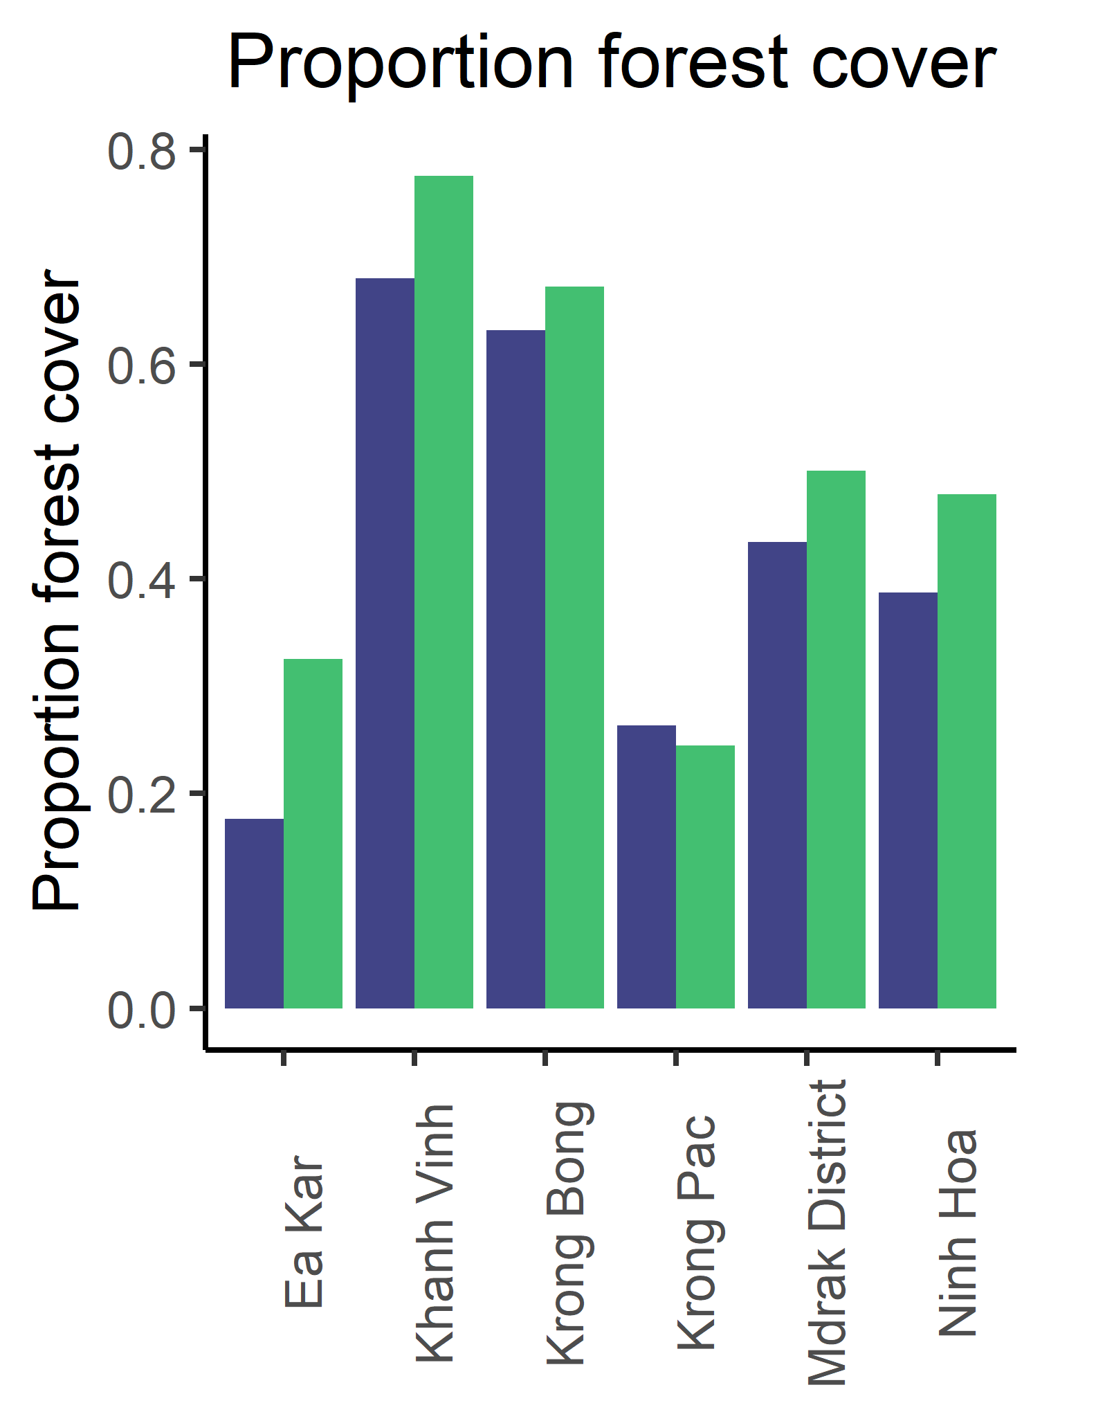
Extracting land cover-land use metrics from raster data
Overlay polygons/points, extract and summarise…
Notes:
Generally with disease data we’re working with polygons which present challenges for interpretation
Conversely with point data you could extract a consistent buffer that you expect has some biological/epi relevance
Extract using exactextractr
Lots of metrics you can derive – what links to the process we’re trying to explore/proxy for/question we’re trying to answer
We’ll explore this in a few minutes in the R tutorial

Slide 19
Examples of present-day land cover sources
Database | Spatial resolution | Temporal resolution | Thematic resolution | Time period
MODIS Land Cover Dynamics | 500m | Annual | Up to 40 classes, categorical | 2001-2019
MODIS Vegetation Indices (EVI/NDVI) | 500m | 16-day | 1 class (vegetation greenness) | 2000-2021
Global Forest Change (Hansen) | 30m | Annual | 1 class (tree cover, loss and gain) | 2000-2019
Global Urban Footprint | 12m | 1 epoch | 1 class (impervious or not) | 1 year ("present day")
Landsat Urban Dynamics (Liu 2020) | 30m | Annual | 1 class (urban cover, loss and gain) | 1985-2015
COPERNICUS Land Cover | 100m | Annual | 23 classes plus fractional cover | 2015-2019
ESA-CCI Land Cover | 300m | Annual | 37 classes, categorical | 1992-2019
Notes:
Often a trade off between spatial and temporal resolution (but not always)
Broad multi-class: ESACCI; MODIS; COPERNICUS
Spatial and temporal detail but thematically restricted: Hansen, Liu landsat
Vegetation indices: EVI/NDVI from COPERNICUS and MODIS
Extremely fine-scale but temporally and thematically restricted: Global Urban Footprint (GUF) https://www.dlr.de/eoc/en/desktopdefault.aspx/tabid-9628/16557_read-40454/

Slide 20
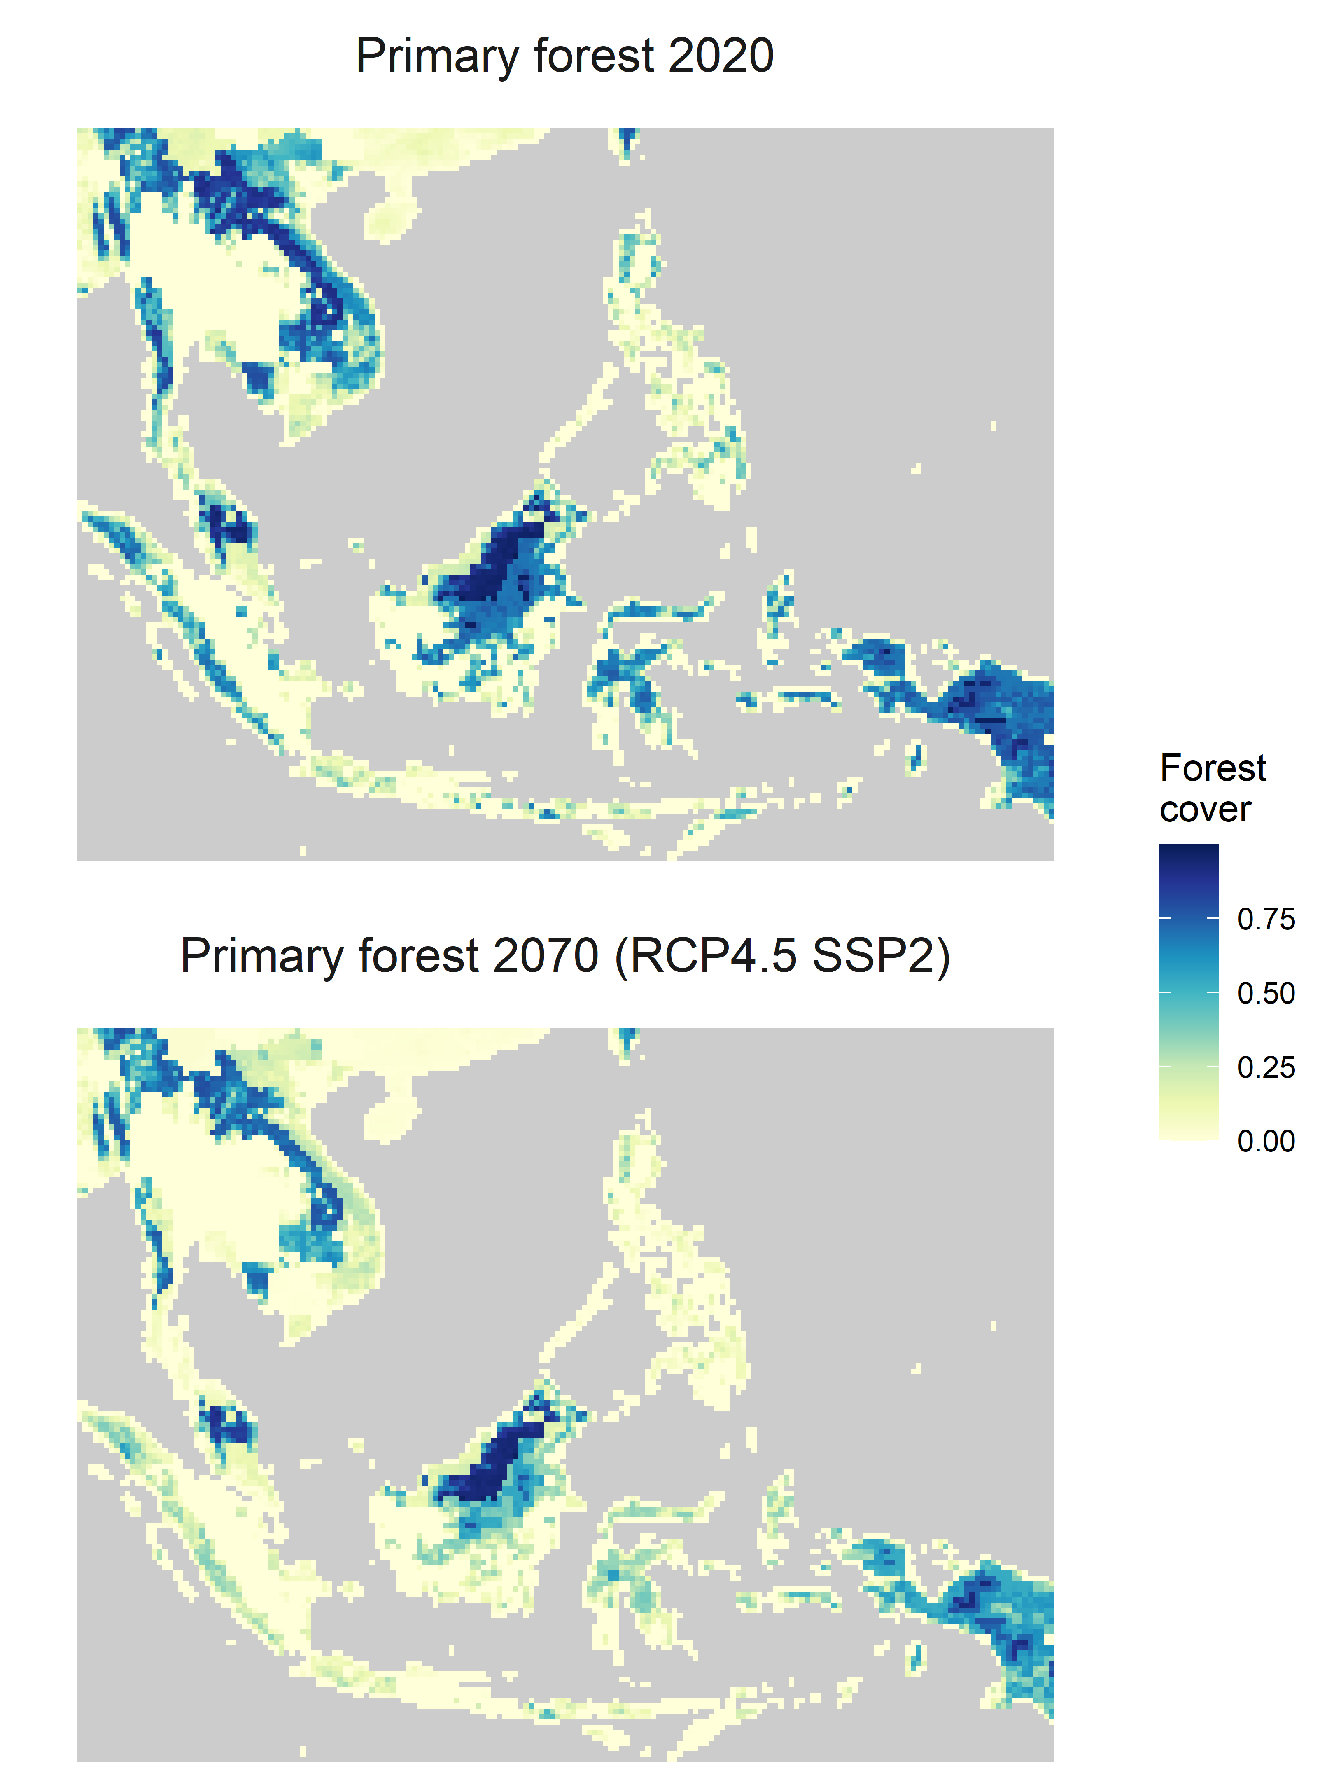
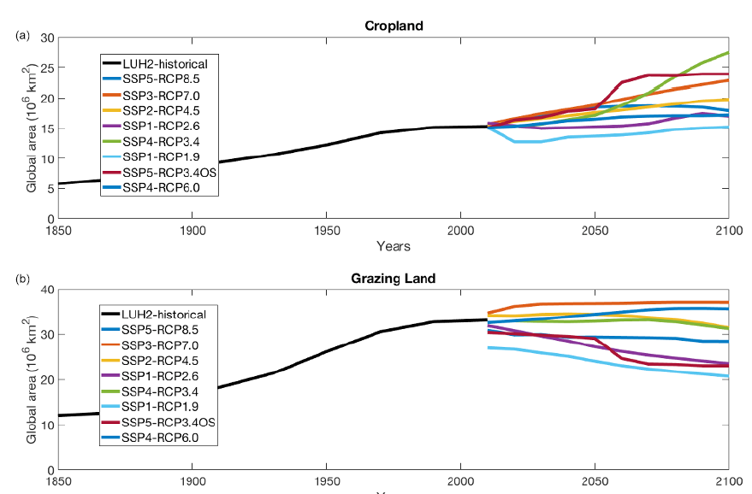

Future scenarios of land use change
Land Use Harmonization v2
Hurtt et al. 2020
Time series of modelled future global land use trajectories, developed under Shared Socioeconomic Pathway (SSP) scenario assumptions for CMIP6 (available as 0.5-degree rasters).
Notes:
Land Use Harmonization

Slide 21
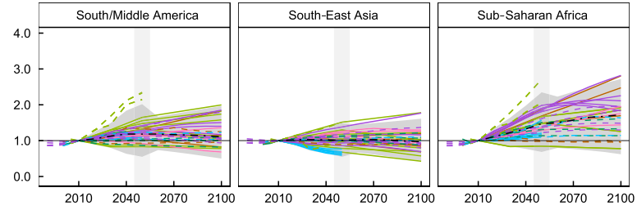
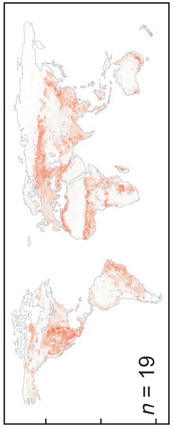
Big uncertainties and caveats for future land use data
Extremely high uncertainty in future cropland area change (proportion change from 2010 baseline) across multiple models and scenarios
The global SSPs and Land Use Harmonization products were mainly produced and designed to feed into climate change models – not health impact modelling.
RCP-SSP scenario pairs are each quantified for LUH using a different Integrated Assessment Model (each of which is structured very differently) – so different modelled LUH scenarios are not strictly comparable.
What this means is that LUH SSP-RCP scenario projections describe only a very small region of possible futures, which are produced under very conservative economic assumptions – need to use and interpret with care for disease models.
Cropland uncertainty (grid cell s.d.) in 2050
Prestele et al. 2017
Notes:
Land Use Harmonization
Modelled and important to note some caveats/issues that arise when using these kinds of data – lack of comparability
Uncertainty rarely well quantified and much more difficult to draw future conclusions from than climate data

Slide 22
Now for the interactive bit…
https://github.com/rorygibb/landuse_phid
PHID Dropbox:
PHID > tutorials > gibb_landuse_20200217

